Slide 1
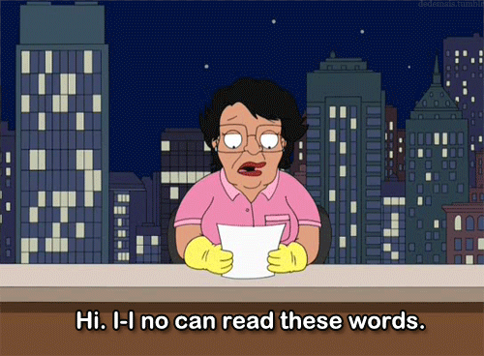
Public Speaking
How do I speak well and kick those nerves!?

Slide 2
YouTube Video link

Slide 3
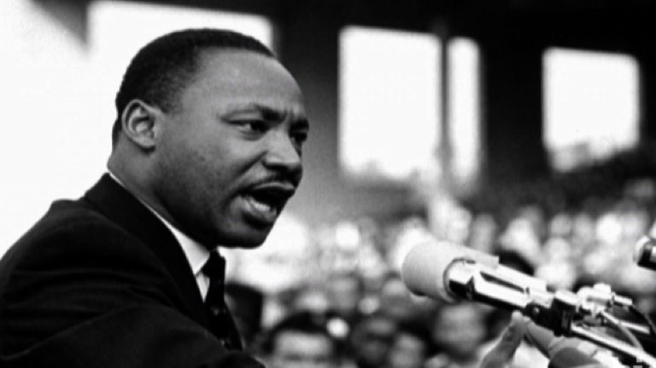
What to focus on
Most people dislike public speaking, particularly when they are young – you are not alone!
But what should you focus on when you are in front of an audience (besides bursting into tears or laughter)?
Volume
Pitch
Tone
Pace
Gestures
Eye Contact
Posture

Slide 4
Volume
This one is pretty easy. Speak loudly.
The louder, the better!
Short of screaming, the more you project your voice, the better you will be at public speaking.
Why? Because it promotes confidence, enables your audience to hear you, and makes you sound like you know what you’re talking about!

Slide 5
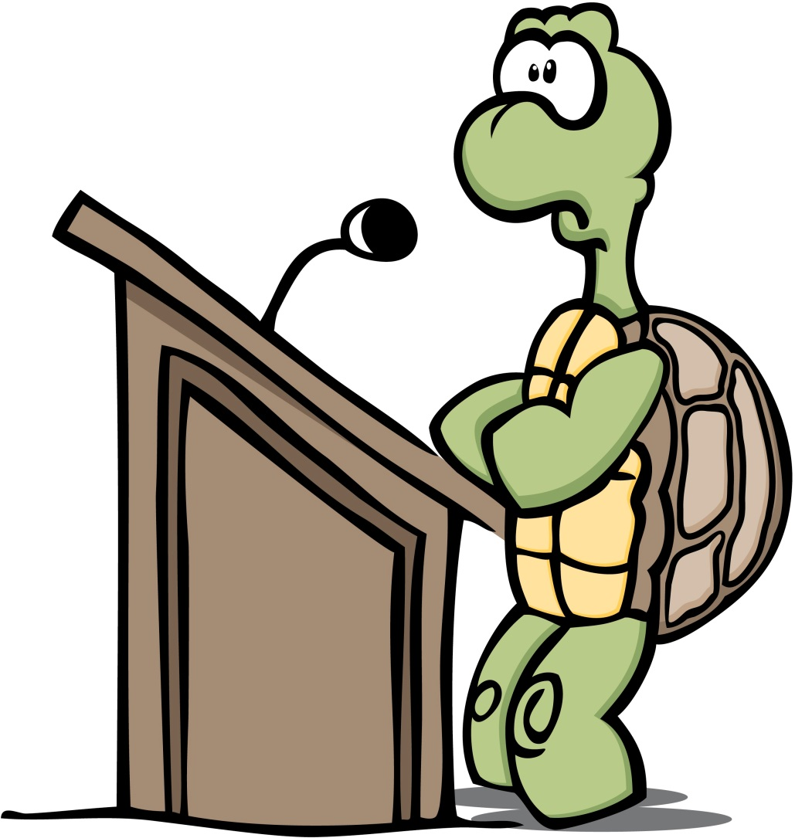
Pitch
Pitch is “the degree of highness or lowness of a tone.”
Girls often have higher pitched voices than boys, but you should always try to vary your pitch.
Why? Because it makes your speech more interesting.
Say this whole sentence in the same pitch. Sounds boring doesn’t it?
We don’t want to bore our audience to death, so change your pitch!

Slide 6
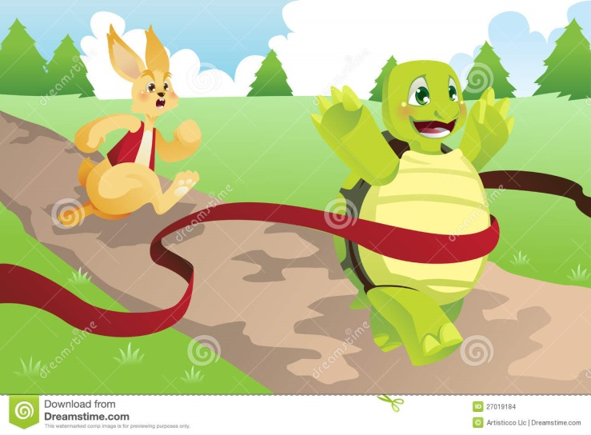
Pace
Pace is how fast you talk. You need to find a good balance between super fast and turtle-slow.
When public speaking, it is often best to vary your pace. Slow down for really…important…bits…that…you…want… to…emphasise!
You may like to speed up at parts that are less important.

Slide 7
Tone
Tone is a combination of things; your pitch, pace, and volume all contribute to your tone. Think about your tone in two ways. Are you trying to be formal (e.g. at a wedding or on school assembly) or informal (talking to friends, chatting on Facebook).
For school speeches you will mostly want to sound formal – but not like a robot! Formal doesn’t mean you always have to be entirely serious, but it means that you’re using the appropriate language, pace, posture, etc. for your topic and setting.
Try to practice with different degrees of formality to strike the perfect balance.

Slide 8
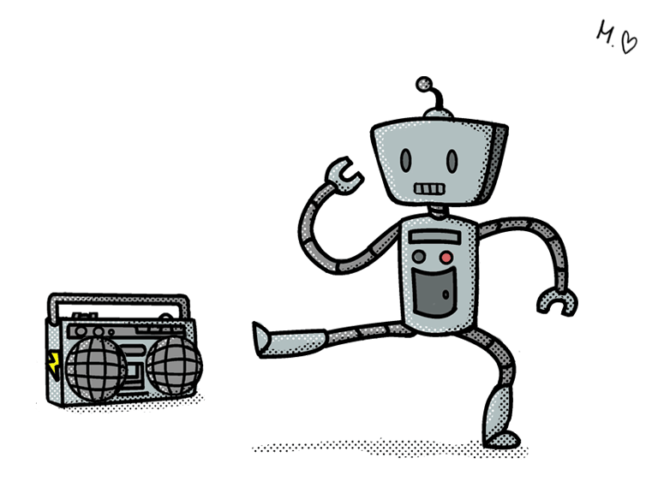
Gestures
Don’t stand like a robot!
Use your arms and hands to emphasise points and draw in your audience.
It makes you look less nervous and it will make you feel less nervous!

Slide 9
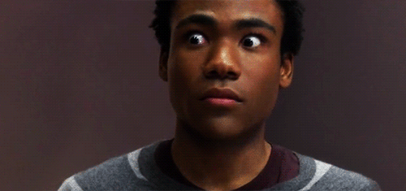
Eye Contact
With everything else, the key to eye contact is that sweet spot between glaring at your paper the entire speech, and staring right into the souls of your audience.
Try to look up and engage your audience every few sentences. This makes them pay more attention and feel included. You really have to be familiar with your speech to be able to make eye contact. Look at different areas of the room, don’t just stare at one spot!
TIP: You don’t have to ACTUALLY look into people’s eye’s, you can look past them ☺ Looking just over the tops of their heads at the back wall is often a good tip.

Slide 10
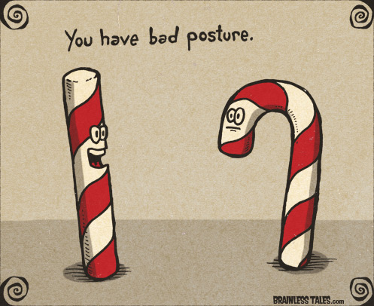
Posture
This one is really simple. Stand up straight, don’t slouch!
Slouching and leaning makes you look nervous and makes your speech seem informal. It also makes your audience feel like you don’t want to be there, which detracts from the effect of your speech.

